Slide 1
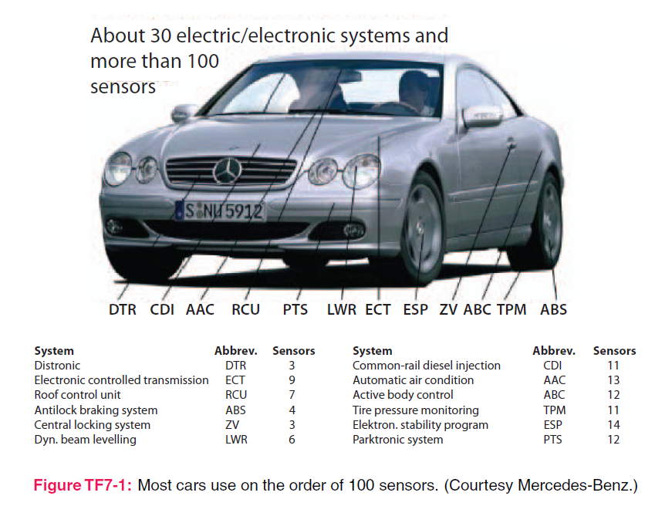
4. Electrostatics
7e Applied EM by Ulaby and Ravaioli

Slide 2
Chapter 4 Overview

Slide 3
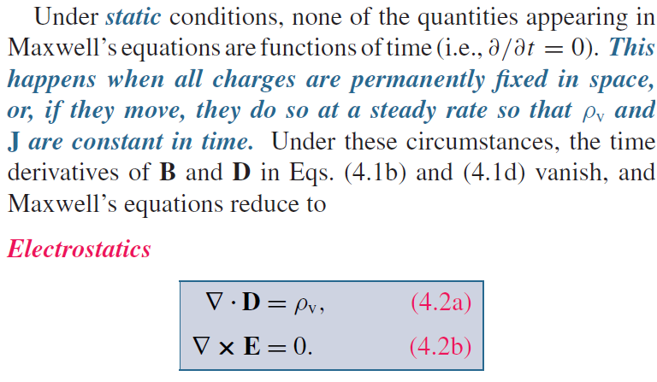
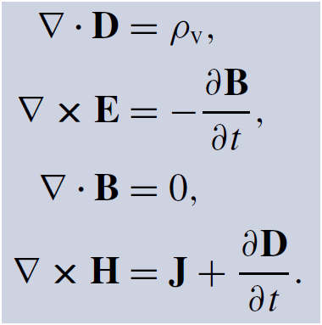
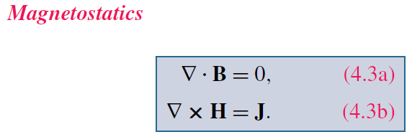
Maxwell’s Equations
God said:
Charge density
Current density
And there was light!

Slide 4
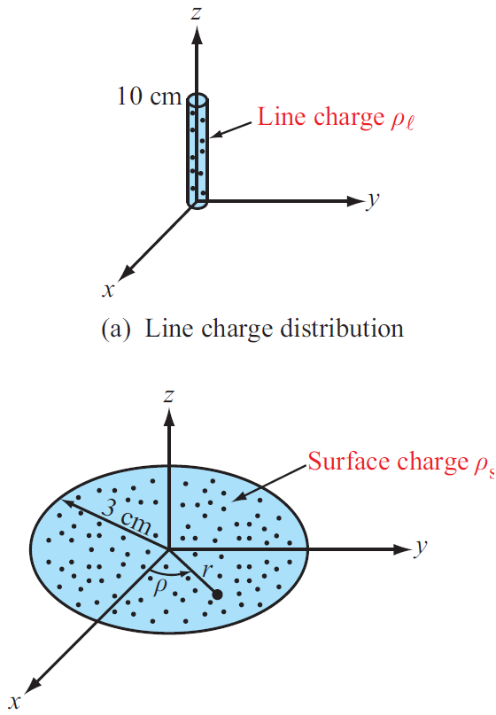
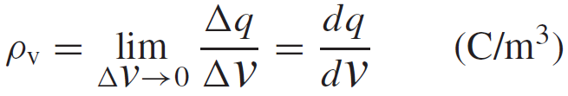
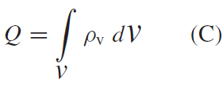
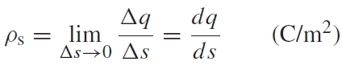
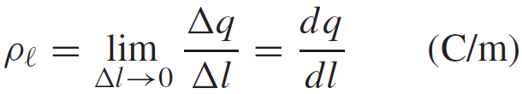
Charge Distributions
Volume charge density:
Total Charge in a Volume
Surface and Line Charge Densities

Slide 5
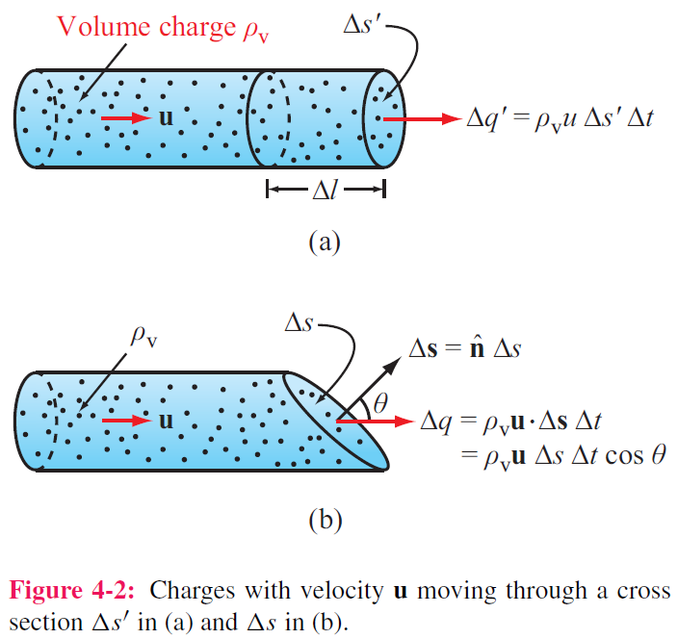
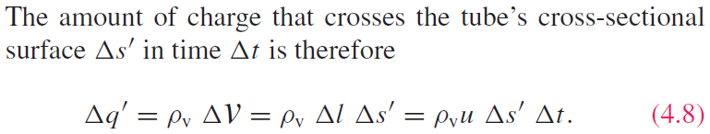
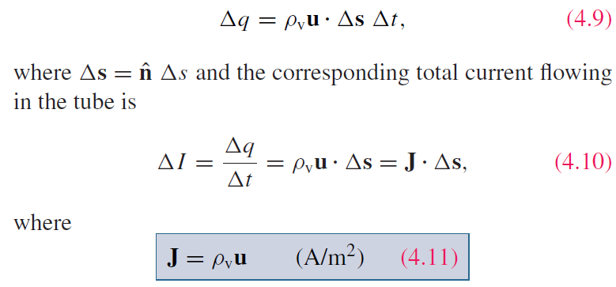
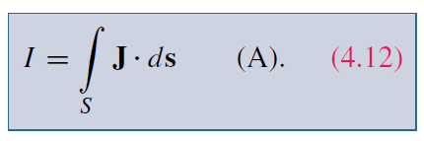
Current Density
For a surface with any orientation:
Charge velocity
Volume current density
J is called the current density
Surface current density

Slide 6
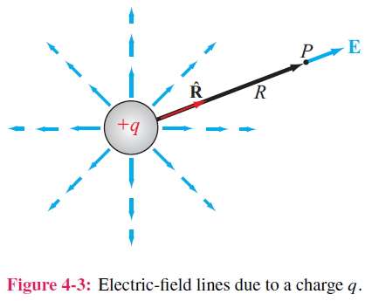
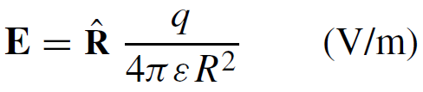
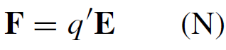
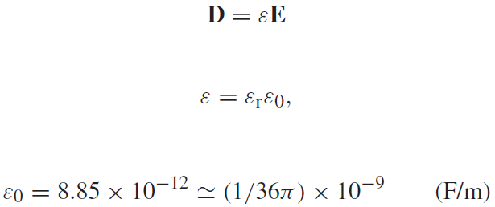
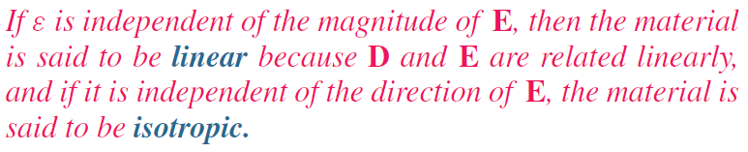
Coulomb’s Law
Electric field at point P due to single charge
Electric force on a test charge placed at P
Electric flux density D

Slide 7
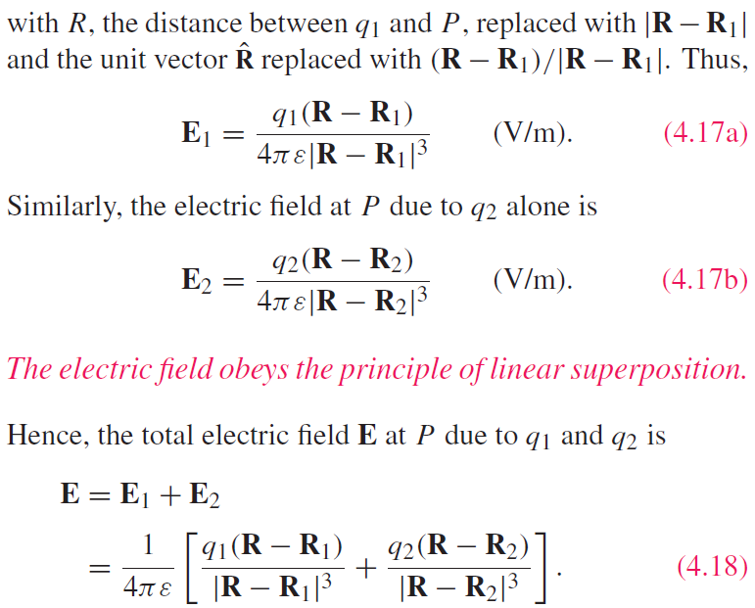
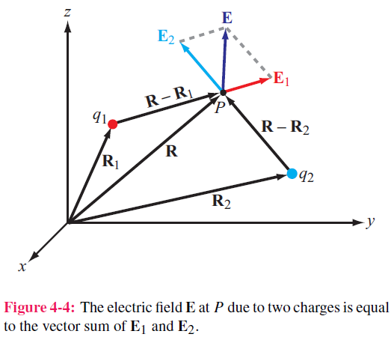
Electric Field Due to 2 Charges

Slide 8
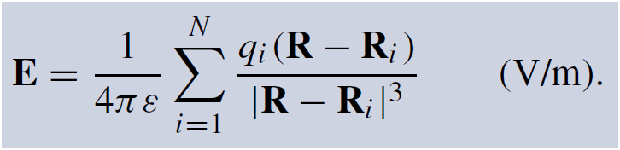
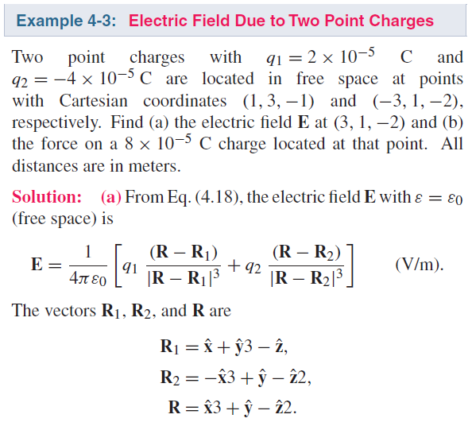
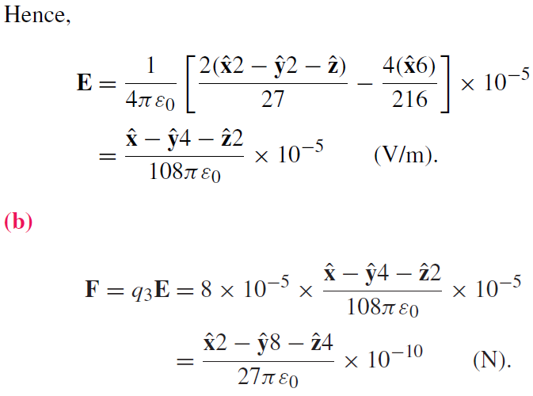
Electric Field due to Multiple Charges

Slide 9
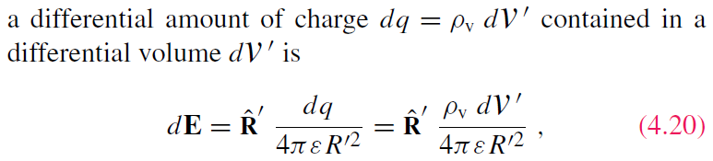
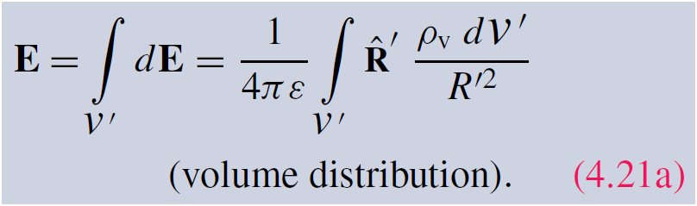
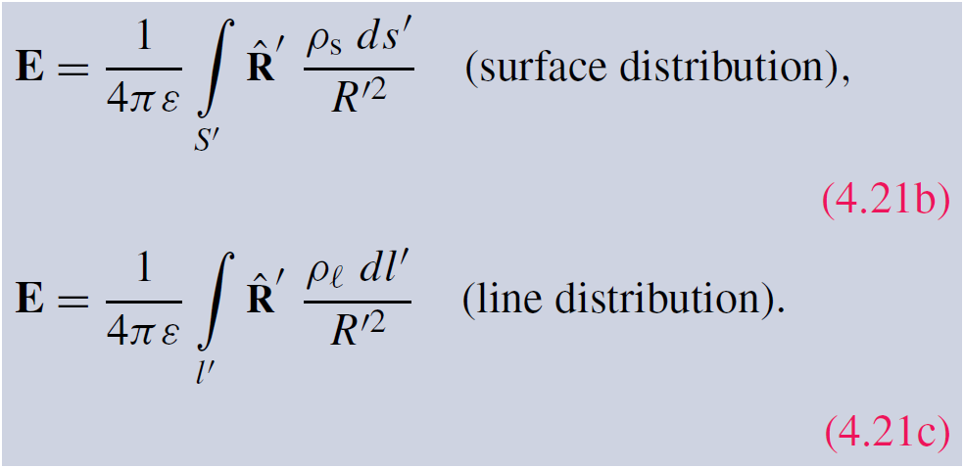
Electric Field Due to Charge Distributions
Field due to:

Slide 10
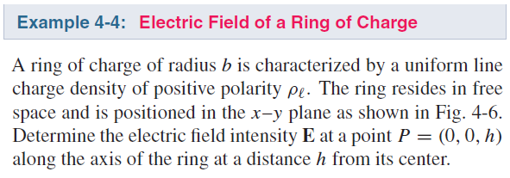
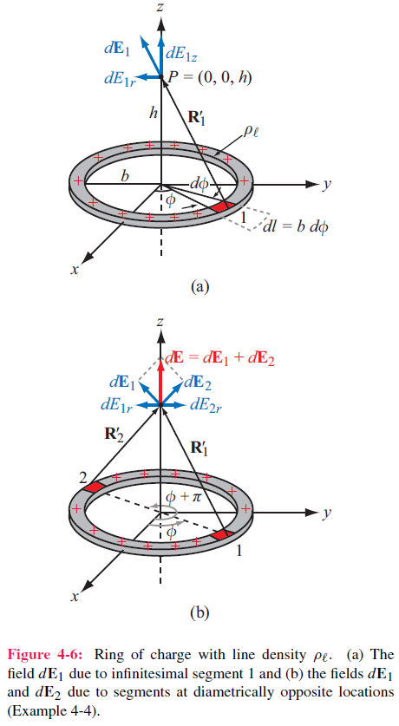
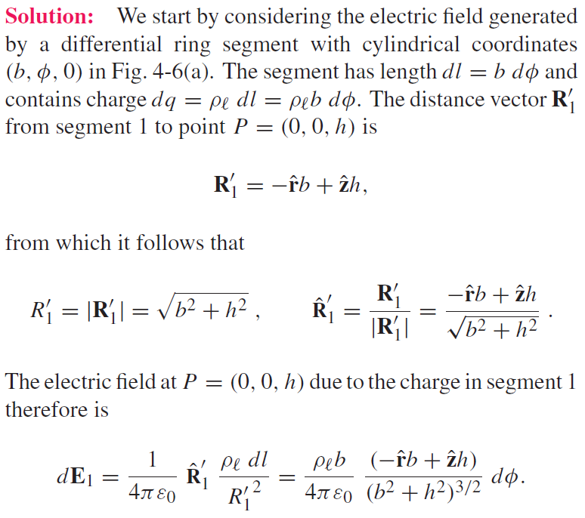
Cont.

Slide 11
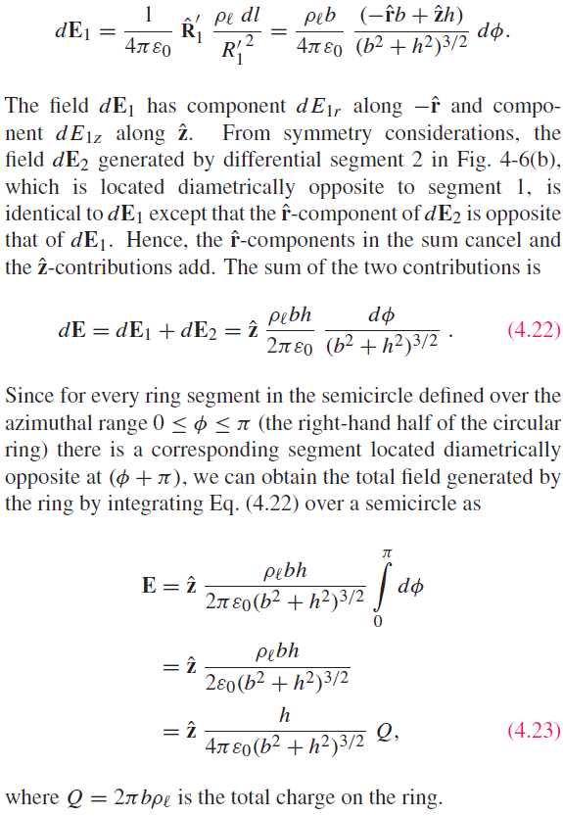

Slide 12
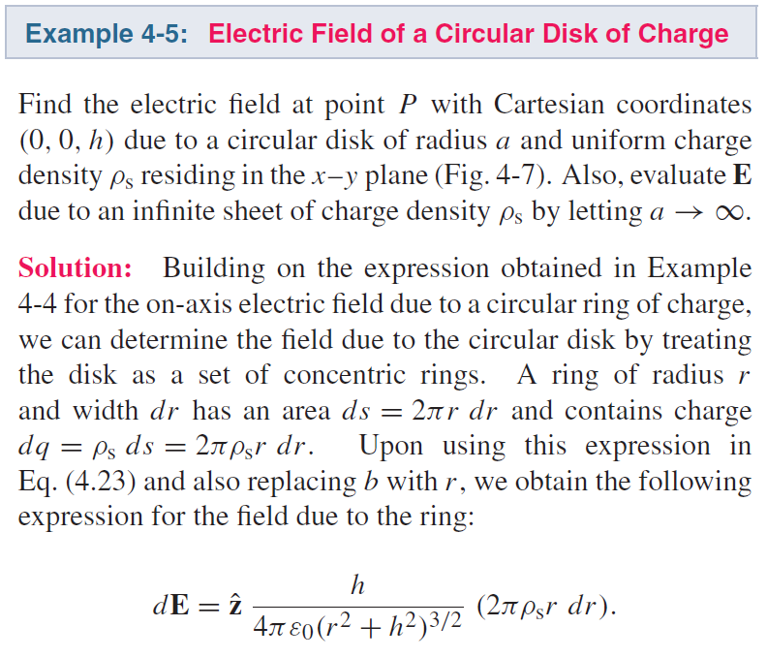
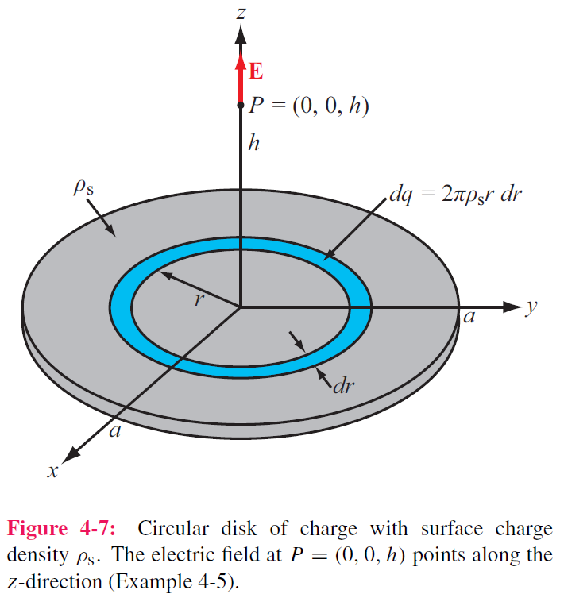
Cont.

Slide 13
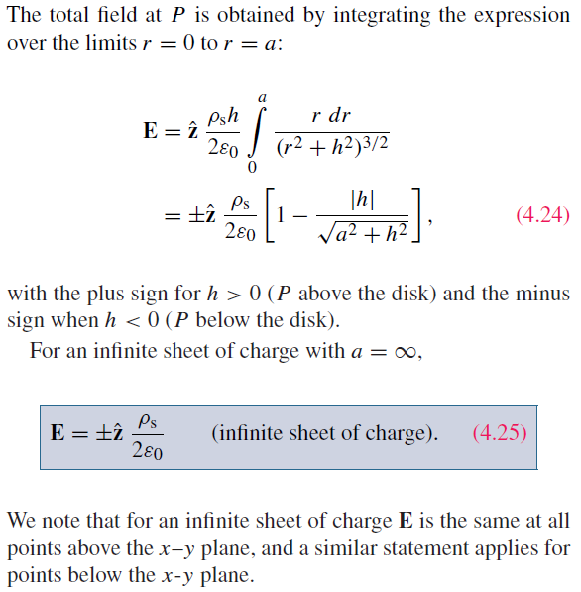
Example 4-5 cont.

Slide 14
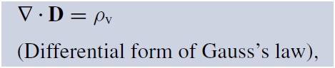
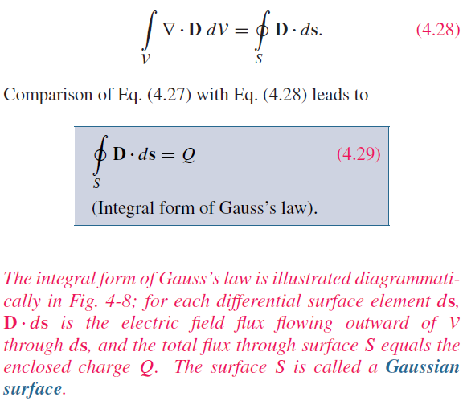
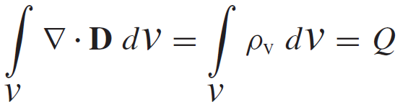
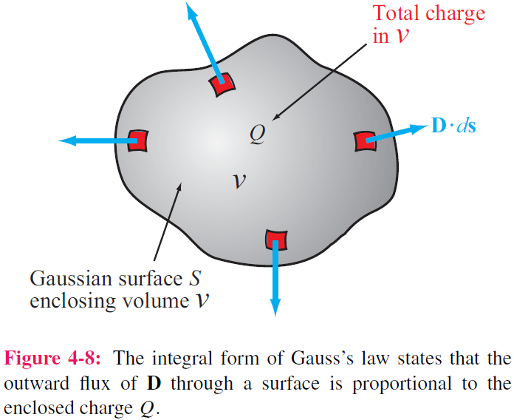
Gauss’s Law
Application of the divergence theorem gives:

Slide 15
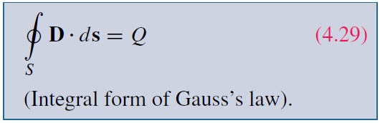
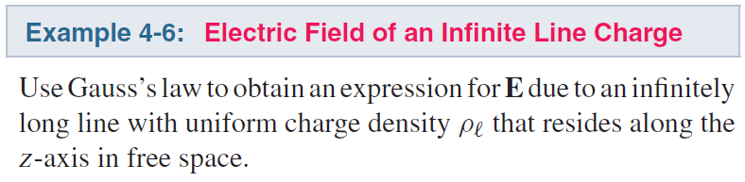
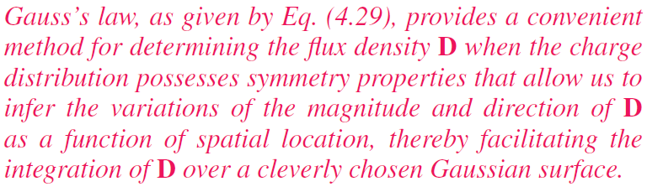
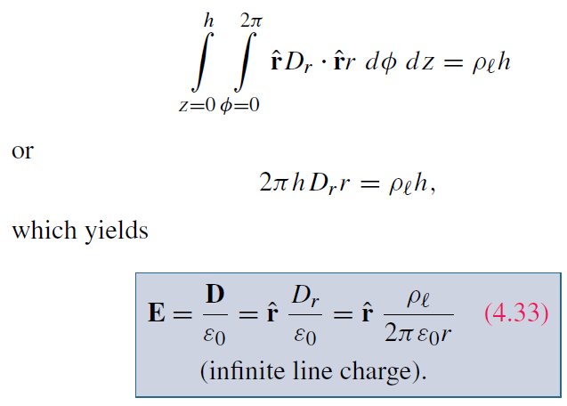
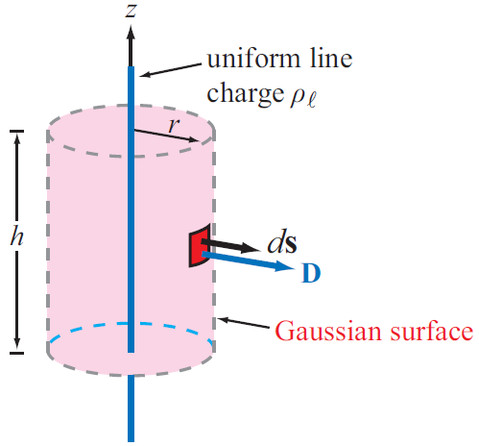
Applying Gauss’s Law
Construct an imaginary Gaussian cylinder of radius r and height h:
D is constant and normal or tangential to the surface
Calculate divE

Slide 16
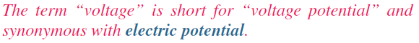
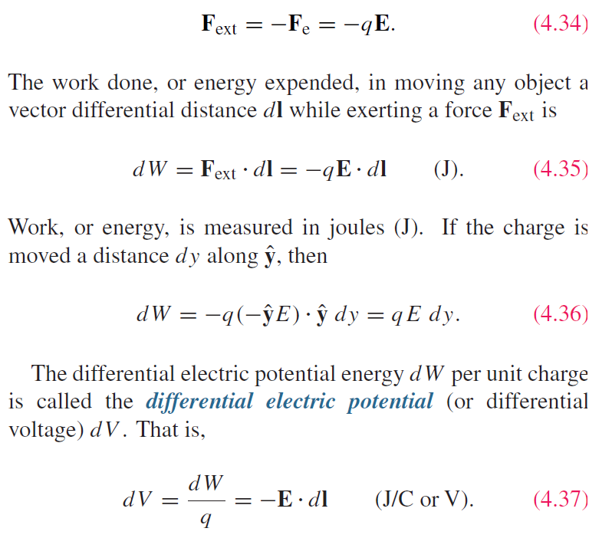
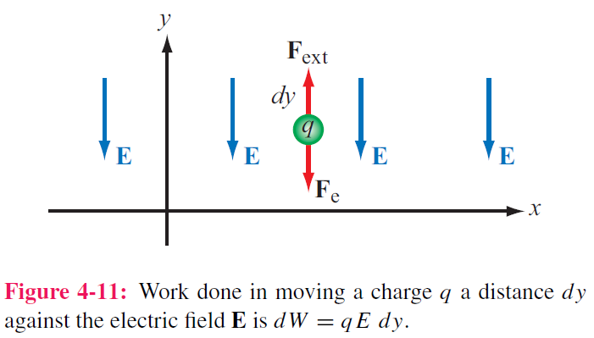
Electric Scalar Potential
Minimum force needed to move charge against E field:

Slide 17
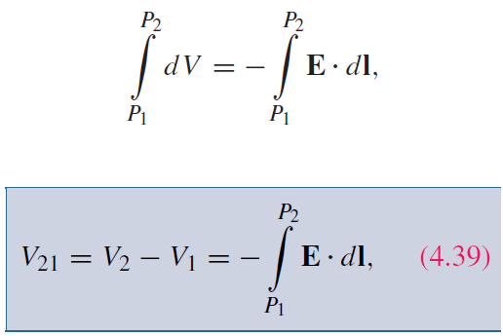
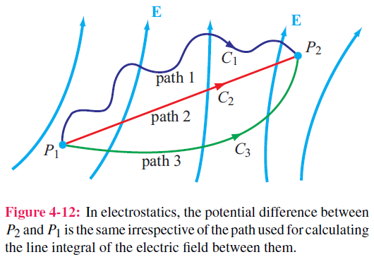
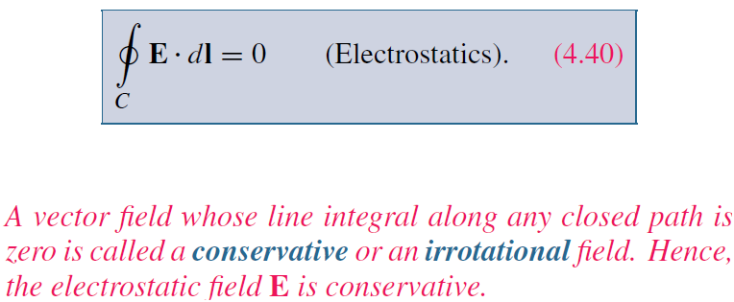
Electric Scalar Potential
The potential difference corresponding to moving a point charge from point P1 to point P2 is obtained by integrating Eq. (4.37) along any path between them

Slide 18
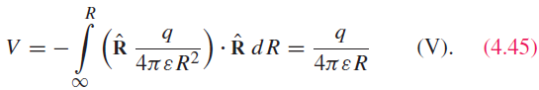
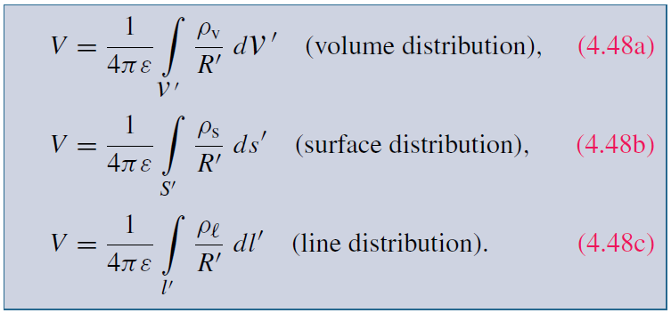

Electric Potential Due to Charges
For a point charge, V at range R is:
In electric circuits, we usually select a convenient node that we call ground and assign it zero reference voltage. In free space and material media, we choose infinity as reference with V = 0. Hence, at a point P
For continuous charge distributions:

Slide 19


Relating E to V

Slide 20


Cont.

Slide 21



(cont.)

Slide 22


Poisson’s & Laplace’s Equations
In the absence of charges:

Slide 23




Conduction Current
Conduction current density:
Conductivity
Constitutive Parameters
Electric permittivity ε
Magnetic permeability μ
Conductivity σ
Note how wide the range is, over 24 orders of magnitude

Slide 24

Conductivity
ρ_{ve} = volume charge density of electrons
ρ_{he} = volume charge density of holes
μ_{e} = electron mobility
μ_{h} = hole mobility
N_{e} = number of electrons per unit volume
N_{h} = number of holes per unit volume

Slide 25



Resistance
Longitudinal Resistor
For any conductor:

Slide 26



G’=0 if the insulating material is air or a perfect dielectric with zero conductivity.

Slide 27



Joule’s Law
The power dissipated in a volume containing electric field E and current density J is:
For a coaxial cable:
For a resistor, Joule’s law reduces to:

Slide 28


Dielectric Materials

Slide 29

Electric Breakdown
Electric Breakdown

Slide 30




Boundary Conditions
$$∆h→0$$
Tangential electric field is continuous

Slide 31



Cont.
$$∆h→0$$
Normal electric flux density is discontinuous by the amount of surface charge density

Slide 32

What about Volume Charge Density
What about if volume charge density exist across the interface as shown below
Interface
Volume charge distribution with ρ_{v}
So volume charge distribution does not induce discontinuity of D

Slide 33





Slide 34

Summary of Boundary Conditions
Remember E = 0 in a good conductor

Slide 35

Conductors
Net electric field inside a conductor is zero
Obtained from Gauss’ law or boundary condition

Slide 36

Field Lines at Conductor Boundary
At conductor boundary, E field direction is always perpendicular to conductor surface

Slide 39



Capacitance

Slide 40


Capacitance
For any two-conductor configuration:
Generalized form
For any resistor:

Slide 41




Slide 42



Application of Gauss’s law gives:
Q is total charge on the inside of outer cylinder, and –Q is on the outside surface of inner cylinder

Slide 43







Electrostatic Potential Energy
For a parallel-plate capacitor
Electrostatic potential energy density
Energy stored in a capacitor
Total electrostatic energy stored in a volume

Slide 44

Image Method
Only valid for the region above conductor
Image method simplifies calculation for E and V due to charges near conducting planes.
For each charge Q, add an image charge –Q
Remove conducting plane
Calculate field due to all charges

Slide 45



Slide 46



